Slide 1
CASC
Information Session
for
Potential Candidates
Fall Cohort 11
2025-2026
Clear Administrative Services Credential (CASC)
“Preparing Transformational Leaders
for LA County and Beyond”
May 8, 2025
Dr. John Lopez, Coordinator III Educational Leadership Programs Lopez_John@lacoe.edu
Notes:
Fully Accredited-Happy to Report…etc…I am thrilled to share some exciting news—Educational Leadership Programs has successfully obtained accreditation for the Preliminary and Clear Credential Programs (PASC and CASC) without any finds!!! This is a tremendous accomplishment, and it would not have been possible without your dedication, expertise, and unwavering commitment to our candidates.

Slide 2
Educational Leadership Programs
OUR VISION
Preparing aspiring courageous, transformative, and equity driven educators who lead with conviction and humility to uplift their educational community so that every student can thrive in an engaging, inclusive, and safe learning environment.
Notes:
Fully Accredited-Happy to Report…etc…I am thrilled to share some exciting news—Educational Leadership Programs has successfully obtained accreditation for the Preliminary and Clear Credential Programs (PASC and CASC) without any finds!!! This is a tremendous accomplishment, and it would not have been possible without your dedication, expertise, and unwavering commitment to our candidates.

Slide 3
CASC PROGRAM
INFORMATIONAL SESSION
Agenda
I. Introductions
II. CASC Overview
III. Professional Learning Component
IV. Assessment Cycle
V. Leadership Coach Training
VI. Application Process
VII. Tuition Costs
VIII. Questions

Slide 4
CASC: Two Year Program Overview
CANVAS LEARNING MANAGEMENT SYSTEM (LMS)
INTRODUCTIONS

Slide 5
Dr. Aaron Dover, Project Director
Dover_Aaron@lacoe.edu
(562) 401-5412
Dr. John Lopez, Coordinator III (CASC)
Lopez_John@lacoe.edu
(562) 922-6916
Donna Jacobson, Coordinator III (PASC)
Jacobson_Donna@lacoe.edu
(562) 922-6263
Adrien Durley, Administrative Aide
Durley_Adrien@lacoe.edu
(562) 922-6864
Claudin De La Torre, Division Secretary
Delatorre_Claudin@lacoe.edu
(562) 922-6387
Educational Leadership Program
Team

Slide 6
WHO IS IN THE ROOM?
In the chat write the following:
Your name
Your district, charter network, or County Office
Your current role
What job would you like to have in 5 years?
Building
Community

Slide 7
CASC: Two Year Program Overview
CANVAS LEARNING MANAGEMENT SYSTEM (LMS)
CASC OVERVIEW

Slide 8
OUR WHY
Preparing
Highly Effective Educational
Leaders
The need to prepare highly effective school leaders is critical to the success of our students in the current climate.
Research links the role of the principal
to positive student outcomes:
Developing high leverage engagement in instruction
Establishing safe and productive school climates
Facilitating collaborative structures and professional learning
Managing personnel and resources strategically
Creating equitable systems that allow all students to thrive
Challenging/disrupting barriers to access and equity
“It is the principal who enables the local school to come alive- a leader who is equally plugged into the local community and the wider societal context. Together they produce graduates and citizens who are aware of what the world is facing.”
- Michael Fullan, The Principal 2.0 (2023)

Slide 9
OUR IMPACT
Educational Leadership Programs
For over a decade, ELP has supported PreK-12 Educational Leaders through a high-impact program designed to improve learning conditions for students across LA County
1000+
Educational Leaders have been served through our Preliminary and Clear Administrative
Services credentialing programs
Serves a range of educational leaders in a variety of educational settings and capacities (urban, rural, suburban, charter, district, court schools, county office, specialty schools, private)
Graduates and current candidates are culturally and linguistically diverse and mirror LA County’s demographics

Slide 10
CASC:
Equity- Driven Leadership
FINDING OUR TRUE NORTH
Leadership
Purpose
Service
Diversity
Future Focused
Professional Standards
Relevance
Notes:
Our Values…

Slide 11
CASC: Two Year Program Overview
LACOE PROGRAM HIGHLIGHTS
A Customized Induction Plan includes three job embedded goals per year and an individualized professional learning plan.
Online seminars, in person trainings, virtual trainings, and optional
safety academy have real life implications for California Professional Standards for Education Leaders (CPSEL).
Forty hours of one-on-one, job-embedded Leadership Coaching to
support "administrative" daily responsibilities.
Learning Management System, provides a secure online environment for electronic portfolios and assessments.
A final in-person Culmination Celebration with end of year activities.

Slide 12
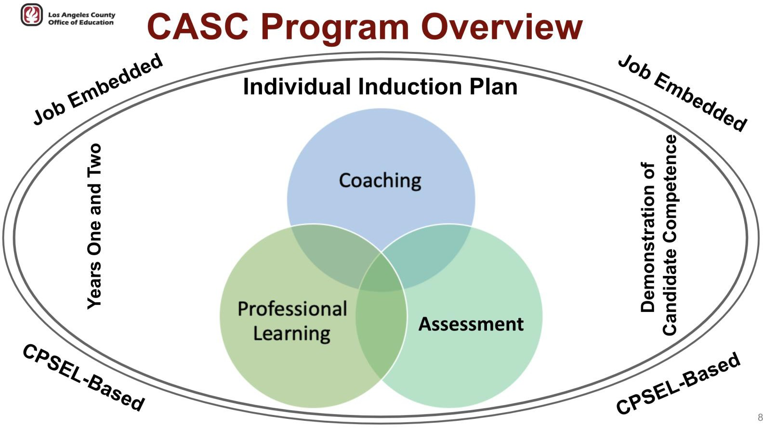
CASC: Two Year Program Overview
CASC: Two Year Program Overview

Slide 13
CASC: Two Year Program Overview
CANVAS LEARNING MANAGEMENT SYSTEM (LMS)
PROFESSIONAL LEARNING COMPONENT, ASSESSMENT CYCLE, AND LEADERSHIP COACHING

Slide 14
CASC: Two Year Program Overview
CASC: Professional Learning

Slide 15
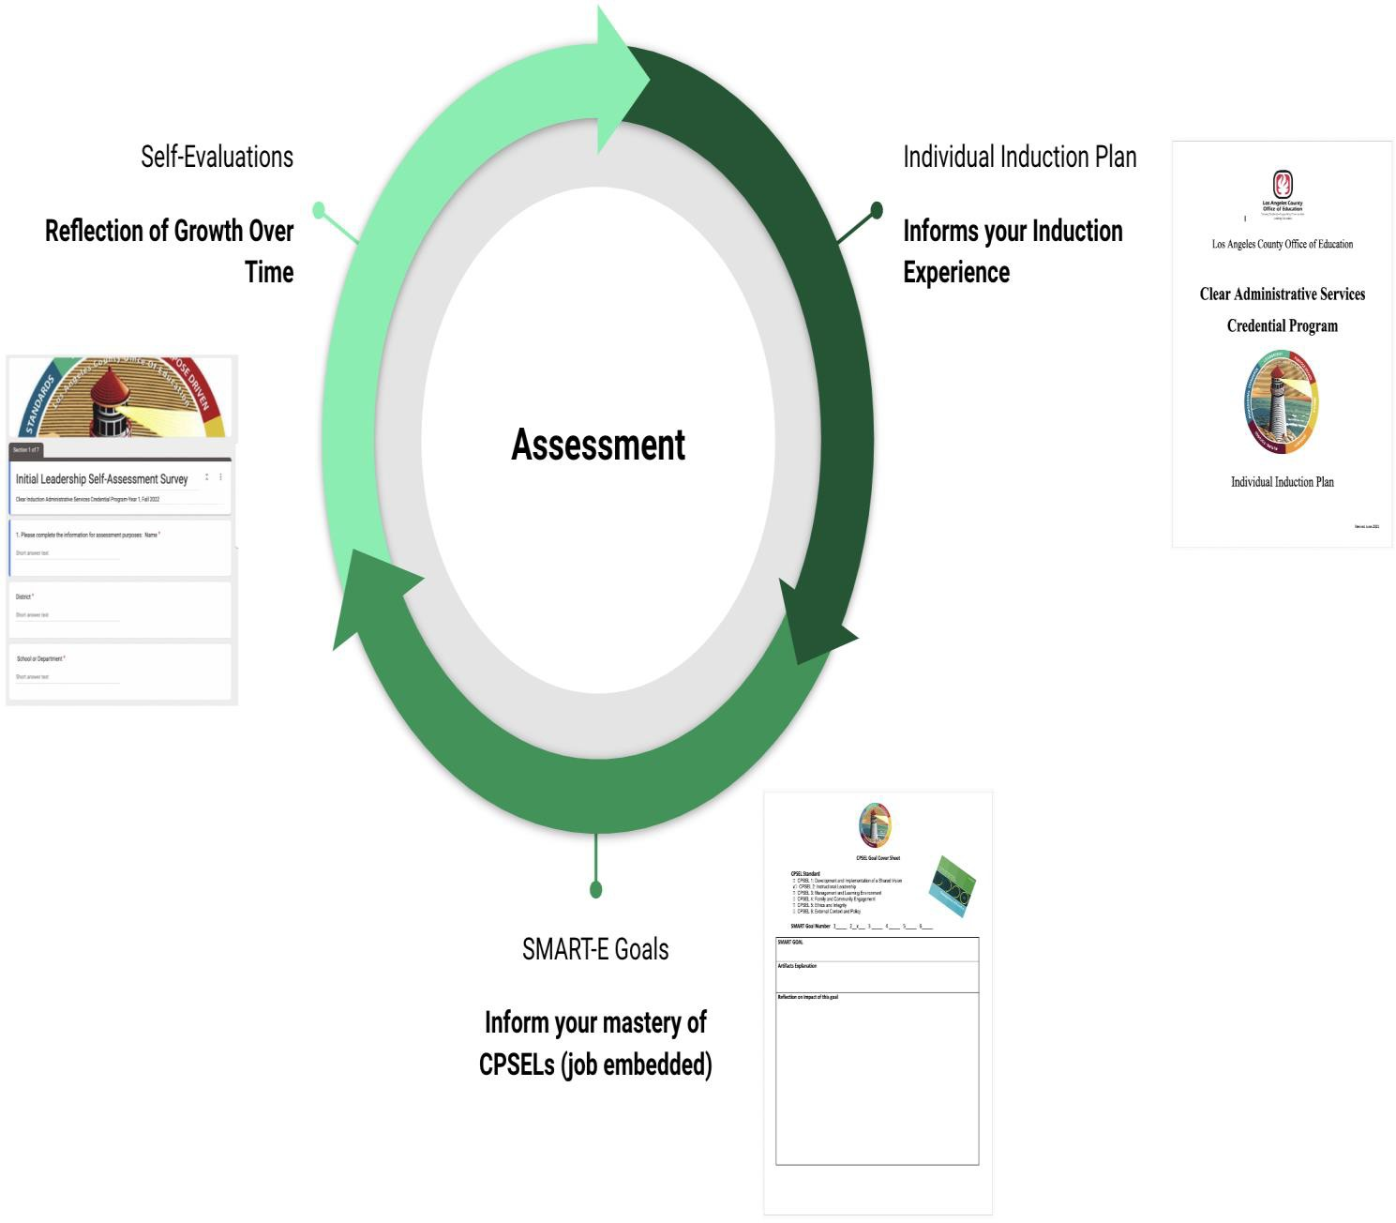
CASC: Two Year Program Overview
CASC: ASSESSMENT CYCLE
SMARTIE Goals
Notes:
Cycles used through our two year program…Inform your IIP Reflect your site and district goals…inform your Smartie Goals Capsules

Slide 16
CASC: Two Year Program Overview
CANVAS LEARNING MANAGEMENT SYSTEM (LMS)
Canvas is Used Throughout LACOE
All CASC materials and resources are housed in CANVAS
All assignments are submitted by candidates through CANVAS
Feedback from assignments will be provided through CANVAS, with options to communicate with assignment reader and coordinator regarding course work and other requirements

Slide 17
CASC: Two Year Program Overview
CASC: LEADERSHIP COACH TRAINING

Slide 18
CASC: Two Year Program Overview
CANVAS LEARNING MANAGEMENT SYSTEM (LMS)
APPLICATION PROCESS AND PROGRAM TUITION

Slide 19
CASC: Two Year Program Overview
COHORT 11 APPLICATION PROCESS
FOR THE 2025/26 PROGRAM YEAR
Application period is from May 1st thru September 1st
Qualifications:
Five years of experience in education (i.e. teacher, counselor, school psychologist)
Degree from an accredited college/university
Valid Preliminary Administrative Services Credential
Current resume
Verification of Employment as an Administrator
Verification of Financial Obligation Form (available on website)
Admission to CASC Program is dependent upon meeting above criteria
Application available on LACOE website:
www.lacoe.edu
Go to "Programs" on Home Page and click on "Educational Leadership Programs"

Slide 20
CASC: Two Year Program Overview
PROGRAM TUITION
Total Cost:
$7,900 for the two-year program
Payment Breakdown:
$500 deposit due after being accepted (holds your spot)
Year 1: Remaining $3,450 due in full or you can make three payment installments
Year 2: $3,950 due in full or you can make three payment installments
Self-Pay:
Candidates may pay in full or over time through the payment plan
Loan options through one of our financial partners
Sallie Mae (Smart Option Student Loan)
Schools First Federal Credit Union (Special Curriculum Loan)
Current employer pays for entire or partial tuition:
Title II
Other funding sources

Slide 21
CASC: Two Year Program Overview
CANVAS LEARNING MANAGEMENT SYSTEM (LMS)
Dr. John Lopez, Coordinator III
Curriculum and Instructional Services
Lopez_John@lacoe.edu

Slide 22
Who is in the room?
In the chat write the following:
Your name
Your district, charter network, or county office
School site or job location
What job would you like to have in 5 years?
Building Community

Slide 23
LACOE PROGRAM HIGHLIGHTS
A Customized Induction Plan includes three job embedded goals per year and an individualized professional learning plan.
Online seminars, in person trainings, virtual trainings, and optional safety academy have real life implications for California Professional Standards for Education Leaders (CPSEL).
Forty hours of one-on-one, job-embedded Leadership Coaching to support "administrative" daily responsibilities.
Learning Management System, provides a secure online environment for electronic portfolios and assessments.
A final in-person Culmination Celebration with end of year activities.

